Slide 1

WELCOME TO CFG
YOUR INTRODUCTION TO
DATABASES & SQL PROGRAMMING LANGUAGE
TECH OPENS UP LIMITLESS OPPORTUNITIES FOR GIRLS
Notes:
1] Welcome students onto the course and introduce CFG! Our mission, why we do what we do and encourage them to share their experience on the course with others.

Slide 2





COURSE JOURNEY
Database design and data visualisation
Project presentations and mock interviews
MODULE 7
MODULE 8
Data management using SQL coding techniques
MODULE 6
Data analysis for complex structures
Data manipulation with SQL programming language
Data analysis for complex structures
MODULE 4
MODULE 5
MODULE 4
Data analysis
MODULE 3
Introduction to SQL programming language and Data Science
SQL coding and Database management technique
MODULE 1
MODULE 2

Slide 3
MODULE 1: HTML
DATA ANALYSIS FOR COMPLEX STRUCTURES
Joins – create complex data structures within DB
Data subset unions
SQL programming - subqueries
04

Slide 4

HOMEWORK REVIEW
The main objective of week 3 homework was to write various queries using logical operators, keywords, aggregation and sorting techniques to analyse sales data for a chain of stores.
Let’s walk through and review the correct answers together.
Notes:
See if anyone want to volunteer to share their solutions for the homework queries.
Alternatively, walk students through the answers

Slide 5
SQL JOIN combines columns from two or more tables, based on a related column between them, in a single result set.
There are many different types of JOINs:
JOIN
Inner Join Outer Join Left Outer Join Right Outer Join Full Outer Join | Self and Equi Join Cross Join Natural Join Straight Join Keyword Join

Slide 6
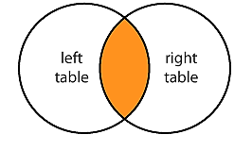
Most typical JOIN, it joins column in first table to second table
It returns rows when there is at least one match in both tables
Cannot deal with NULL values
INNER JOIN
Table 1
ID | VALUE
1 | First
2 | Second
3 | Third
4 | Fourth
5 | Fifth
Table 2
ID | VALUE
1 | First
2 | Second
3 | Third
6 | Sixth
7 | Seventh

Slide 7

SYNTAX
EXAMPLE
What are our customers’ email addresses?
SELECT
<alias1>.<column_name>,
<alias1>.<column_name>,
<alias2>.<column_name>
FROM <table_name1> <alias1>
INNER JOIN
<table_name2> <alias2>
ON
<alias1>.<column_name> =
<alias2>.<column_name>;
SELECT
c.name, c.surname,
e.email_address
FROM customers c
INNER JOIN
email_address e
ON
c.customer_id =
e.email_address_customer_id;
INNER JOIN
ON clause

Slide 8
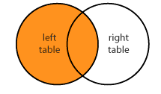
All rows from the left side with the matching rows from the right side will be returned
If there are no columns matching in the right table, it returns NULL values
LEFT OUTER*
JOIN
Table 1
ID | VALUE
1 | First
2 | Second
3 | Third
4 | Fourth
5 | Fifth
Table 2
ID | VALUE
1 | First
2 | Second
3 | Third
6 | Sixth
7 | Seventh
The ‘OUTER’ keyword is optional
Notes:
Review examples on sandbox: https://coderpad.io/sandbox
Explain how it works: show two tables separately first employees, then departments and then write the query
SELECT e.first_name, e.last_name, e.salary,
d.name as department_name
FROM employees AS e
JOIN departments AS d ON e.department_id = d.id;

Slide 9
SYNTAX
EXAMPLE
What are our customers’ email addresses including those that we don’t have an email address for?
SELECT
<alias1>.<column_name>,
<alias1>.<column_name>,
<alias2>.<column_name>
FROM <table_name1> <alias1>
LEFT JOIN
<table_name2> <alias2>
ON
<alias1>.<column_name> =
<alias2>.<column_name>;
SELECT
c.name, c.surname,
e.email_address
FROM customers c
LEFT JOIN
email_address e
ON
c.customer_id =
e.email_address_customer_id;
LEFT OUTER JOIN
ON clause

Slide 10
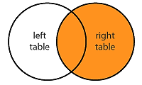
Opposite of the LEFT OUTER JOIN, i.e. all rows from the right side with the matching rows from the left side will be returned
If there are no columns matching in the left table, it returns NULL values
RIGHT OUTER*
JOIN
Table 1
ID | VALUE
1 | First
2 | Second
3 | Third
4 | Fourth
5 | Fifth
Table 2
ID | VALUE
1 | First
2 | Second
3 | Third
6 | Sixth
7 | Seventh
The ‘OUTER’ keyword is optional

Slide 11
SYNTAX
EXAMPLE
What are the email addresses we have, including those email that we don’t have a matching customer for?
SELECT
<alias1>.<column_name>,
<alias1>.<column_name>,
<alias2>.<column_name>
FROM <table_name1> <alias1>
RIGHT JOIN
<table_name2> <alias2>
ON
<alias1>.<column_name> =
<alias2>.<column_name>;
SELECT
c.name, c.surname,
e.email_address
FROM customers c
RIGHT JOIN
email_address e
ON
c.customer_id =
e.email_address_customer_id;
RIGHT OUTER JOIN
ON clause

Slide 12
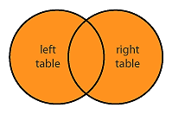
Combines left outer join and right outer join
Returns rows from either table when the conditions are met and returns a null value when there is no match
MySQL DOES NOT SUPPORT FULL OUTER JOIN SYNTAX!
But we can simulate this join by combining LEFT and RIGHT joins with UNION (don’t worry about it now – we learn more about UNIONs soon!
FULL OUTER*
JOIN
Table 1
ID | VALUE
1 | First
2 | Second
3 | Third
4 | Fourth
5 | Fifth
Table 2
ID | VALUE
1 | First
2 | Second
3 | Third
6 | Sixth
7 | Seventh
The ‘OUTER’ keyword is optional

Slide 13

PRACTICE
We are going to create two simple tables and join them together using different types of joins.
The most important thing for us right now is to understand the join mechanism and the SQL syntax that we need to write to perform a join.
Let’s create two tables aka two fruit baskets and see how we can join them!
Type along with your instructor ☺.
Notes:
1. Navidate

Slide 14
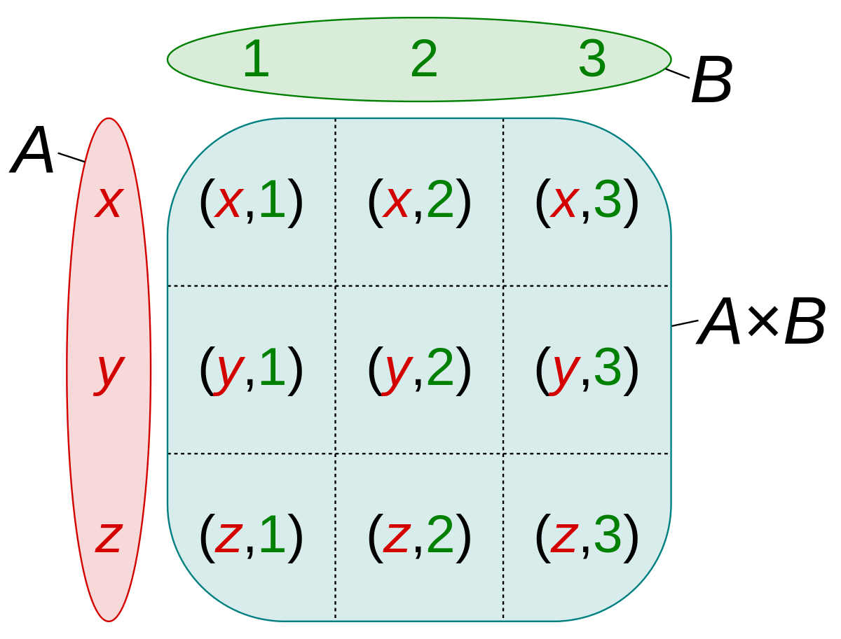
Simplest, but quite inefficient
There is no WHERE clause nor any condition for a join, hence all rows from both tables are used
It returns a Cartesian Product – multiples of the record number of both tables
CROSS JOIN
Table 1
ID | VALUE
1 | First
2 | Second
3 | Third
Table 2
ID | VALUE
1 | First
2 | Second
3 | Third
4 | Fourth

Slide 15
You can JOIN the table on itself! Sometimes it can be useful.
No special syntax, but we must alias the table used with different aliases.
We will have the same table on left and right side of this join.
It is especially useful when we deal with a table that contains hierarchical data.
SELF JOIN
Table

Slide 16
EQUI JOIN
NON-EQUI JOIN
Specific type of a JOIN that uses the equal sign as the comparison
Specific type of a JOIN that does not use the equal sign as the comparison
TYPES OF JOINS
NAURAL JOIN
KEYWORD JOIN
Joins two (or more) tables based on all columns in the two tables with the same name
Uses keyword for joining tables when columns have the same name in both tables

Slide 17
PRACTICE
We continue practicing our JOINs queries. Let’s look at the result produced by the CROSS JOIN based on our fruit tables.
Let’s create a small table with hierarchical data and perform a self join to see how useful it can be.
Type along with your instructor ☺.
Notes:
1. Navidate

Slide 18
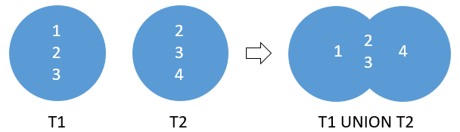
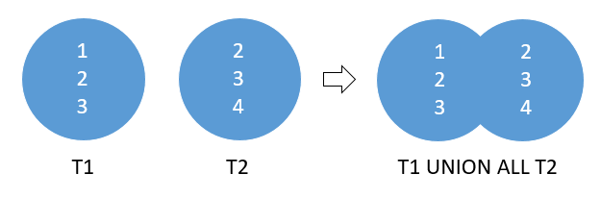
MySQL UNION operator allows to combine two or more result sets of queries into a single result set.
By default, UNION operator removes duplicate rows even if we don’t specify the DISTINCT operator explicitly.
UNION ALL does not remove duplicate rows
UNION
OPERATORS

Slide 19
A subquery is a nested query where the results of one query can be used in another query via a relational operator or aggregation function
A subquery must be enclosed with parentheses
A subquery can have only one column in the SELECT clause if used in WHERE clause
An ORDER BY clause is not allowed in a subquery
Subqueries can be nested within other subqueries
Subqueries are used in WHERE, HAVING, FROM and SELECT clause
SUBQUERY

Slide 20
PRACTICE
We are going to practice more by writing queries with UNION operators (based on the fruit tables).
In addition to that, we are going to write our very first subquery using our customer database.
Type along with your instructor ☺.
Notes:
1. Navidate

Slide 21
HOMEWORK
We will start doing this in class together as part of our practice and the task would be to complete writing the queries, i.e. finishing writing SQL code for answering these questions.
We are going to use the database called parts. These queries are a bit more challenging than usual: they require joins and nested subqueries.
WRITE THE FOLLOWING QUERIES
Find the name and status of each supplier who supplies project J2
Find the name and city of each project supplied by a London-based supplier
Find the name and city of each project not supplied by a London-based supplier
Find the supplier name, part name and project name for each case where a supplier supplies a project with a part, but also the supplier city, project city and part city are the same.

Slide 22



REFERENCE
MATERIALS

Slide 23

QUICK SUMMARY
JOINS are one of the staples in the SQL world. It is one of the most common actions to perform when working with databases.
There are many different types of joins and they are useful in its own way (applicable for different tasks)
JOINS make the relational model come to life by associating tables together2

